Slide 1

KGiSL INSTITUTE OF TECHNOLOGY
COIMBATORE
Department of Computer Science & Engineering
Mini - Project Phase Review # 03
STOCK MARKET ANALYSIS
(2001-2023)
TEAM MEMBERS:
711720104102. Velvizhi S
711720104082. Saswin S
711720104087. Shivarithesh Kumar M
711720104066. Rajesh Kannan G
Under the guidance of :
Mentor: Mr. Sureshkumar R

Slide 2

Agenda
Objective of the project work
Existing System
Proposed System
Expected Outcome
References
Timeline

Slide 3
OBJECTIVE / Abstract
This Stock Market Analysis involves comparing a company’s current financial statement to its financial statements in previous years. Here you could get stock details of these following companies ;
Microsoft
Apple
Amazon
Netflix
Google
To give an investor a sense of whether the company is growing, stable, or deteriorating. Investors or traders make buying or selling decisions based on stock analysis information.

Slide 4
EXISTING SYSTEM
Literature Survey
TITLE | PUBLICATION YEAR | AUTHOR/PUBLISHER | DESCRIPTION
A data-science-driven short-term analysis of Amazon, Apple, Google, and Microsoft Stocks. | 2021 | Shubham Ekapure, Nuruddin Jiruwala, Sohan Patnaik, Indranil SenGupta. | In this paper, implementation of a combination of technical analysis and machine/deep learning-based analysis to build a trend classification model.
A historical analysis of sectors within the US Stock Market 1872-2013 | 2014 | Oliver D Bunn, Robert J Shiller. | This paper, Construct a price, dividend, and earnings series for the Industrial sector, the Utilities sector, and the railroads sector from the beginning of 1870’s until the beginning of the primary sources.

Slide 5
LITERATURE SURVEY
TITLE | PUBLICATION YEAR | AUTHOR/PUBLISHER | DESCRIPTION
Machine Learning in prediction of stock market indicators based on historical data and data from twitter sentiment analysis. | 2013 | Alexander Porshnev, Ilya Redkin, Alexey Shevchenko. | Development of linguistic technologies and penetration of social media provide powerful possibilities to investigate users’moods and psychological states of people.
Python for Finance Cookbook: Over 50 recipes for applying modern python libraries to financial Data Analysis. | 2020 | Eryk Lewinson. | This paper solves common and non-common financial problems using Python Libraries such as numpy, pandas and Scipy.

Slide 6
EXISTING SYSTEM
Existing System
The most common form of ANN in use for stock market prediction is the feed forward network utilizing the backward propagation of errors algorithm to update the network weights.
These networks are commonly referred to as backpropagation networks.
Drawbacks / Pitfalls of the Existing system
Expected Outcome cannot be guaranteed as it is based upon peoples sentiment Analysis.
Risk refers to the possibility of the actual return varying from the expected return.

Slide 7
PROPOSED SYSTEM
Proposed method
Prediction methodologies fall into three broad categories which can overlap. They are fundamental Analysis, Technical Analysis and technological methods
Involve analyzing historical data to predict the likelihood of a future event occurring or forecast future performance.
Advantages over existing method
Gives a Better idea about Entry and Exit Points.
Applying the correct stock market prediction methods helps to know better about entry and exit points.

Slide 8
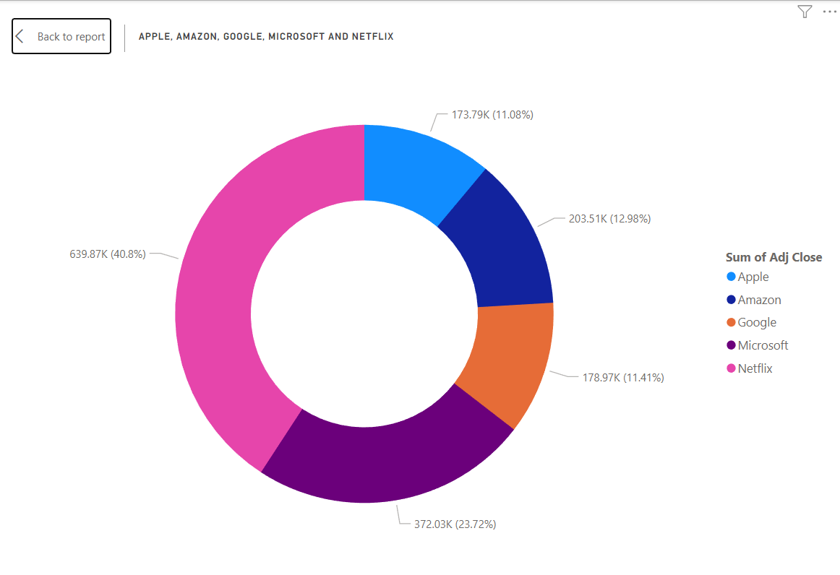
Module-3 Screenshots

Slide 9
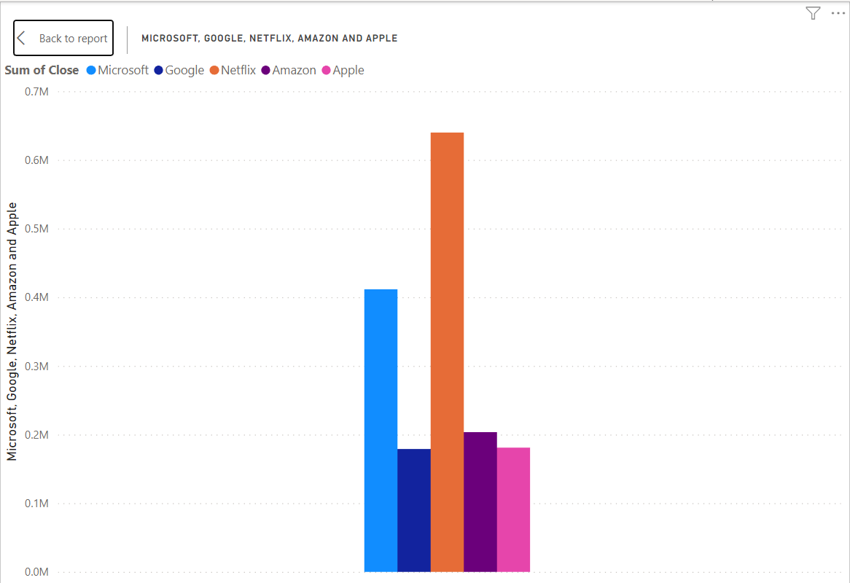

Slide 10
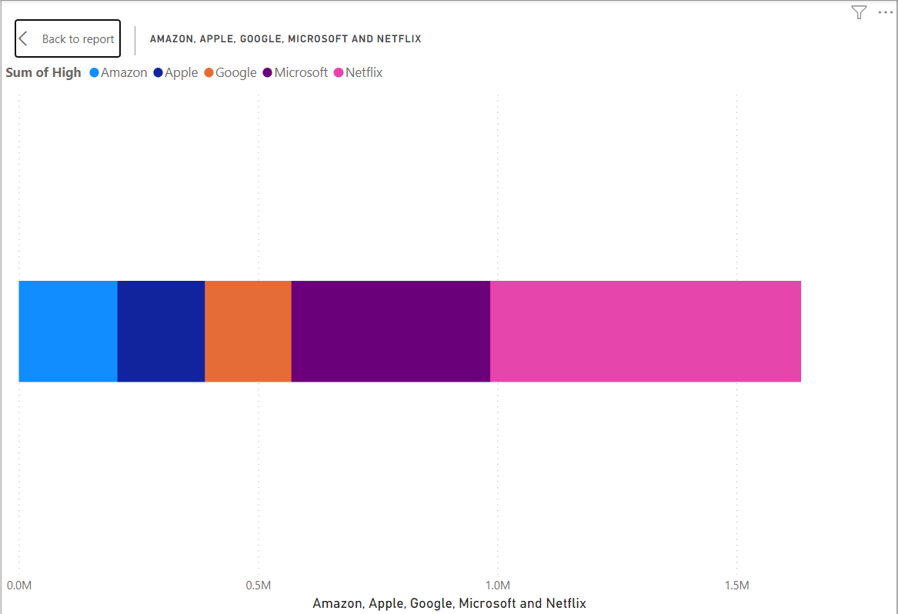

Slide 11
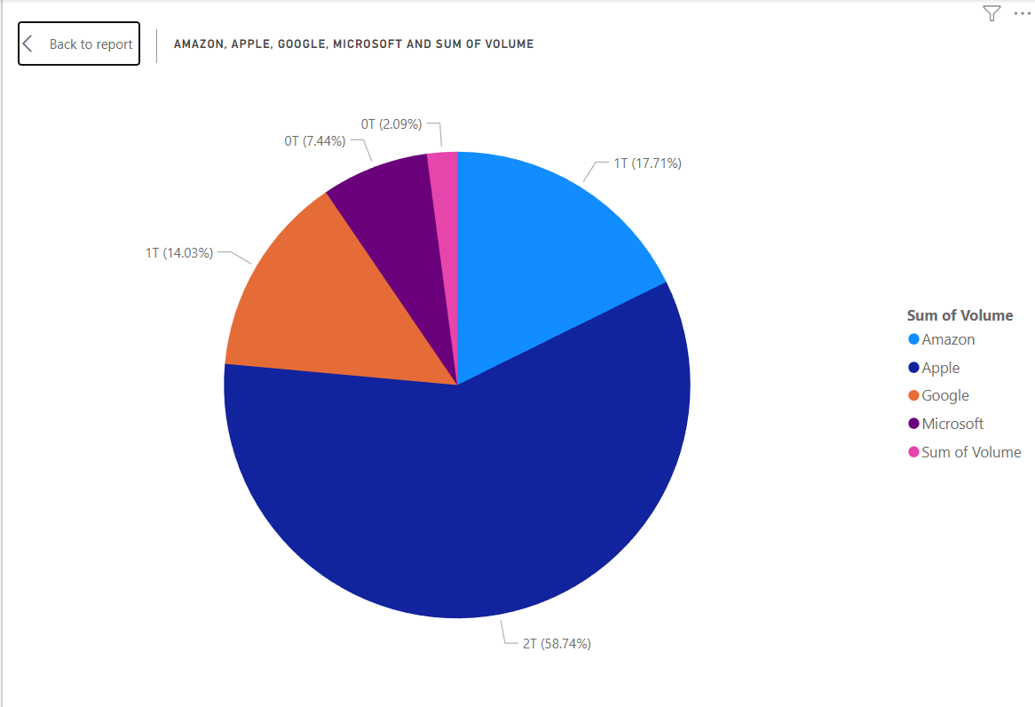

Slide 12
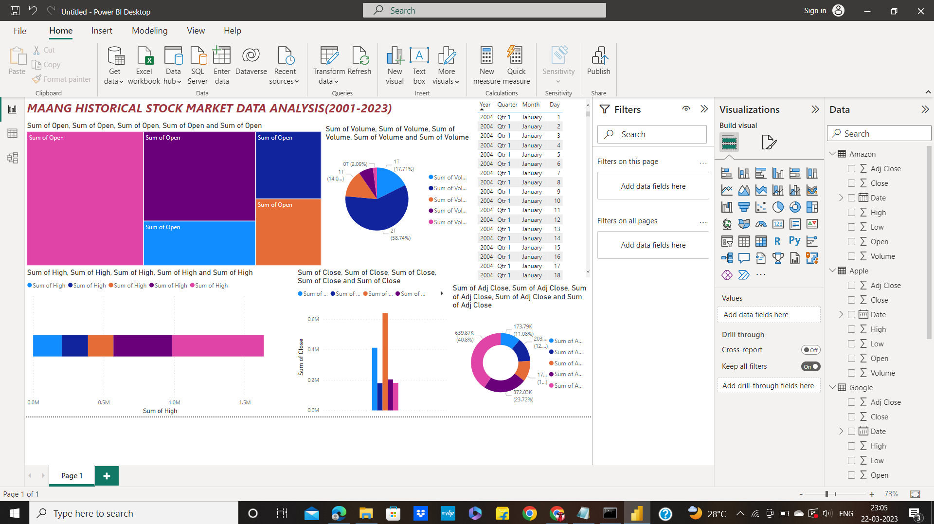

Slide 13
EXPECTED OUTCOME
Financial services company indicating how a particular company’s stock will perform in the coming quarter.
Company’s financial and stock price should perform in the near-to-mid term.
Result in recommendations such as buy, sell, and hold for a stock.

Slide 14
REFERENCE
[1] Shubham Ekapure, Nuruddin Jiruwala, Sohan Patnaik, Indranil SenGupta S 2021, “A data-science-driven short-term analysis of Amazon, Apple, Google, and Microsoft Stocks”.
[2] Oliver D Bunn, Robert J Shiller, “A historical analysis of sectors within the US Stock Market 1872-2013”, National Bureau of Economic Research, 2014.
[3]Alexander Porshnev, Ilya Redkin, Alexey Shevchenko, “Machine Learning in prediction of stock market indicators based on historical data and data from twitter sentiment analysis”, 2013 IEEE 13th International Conference on Data Mining Workshops, 440-444, 2013

Slide 15
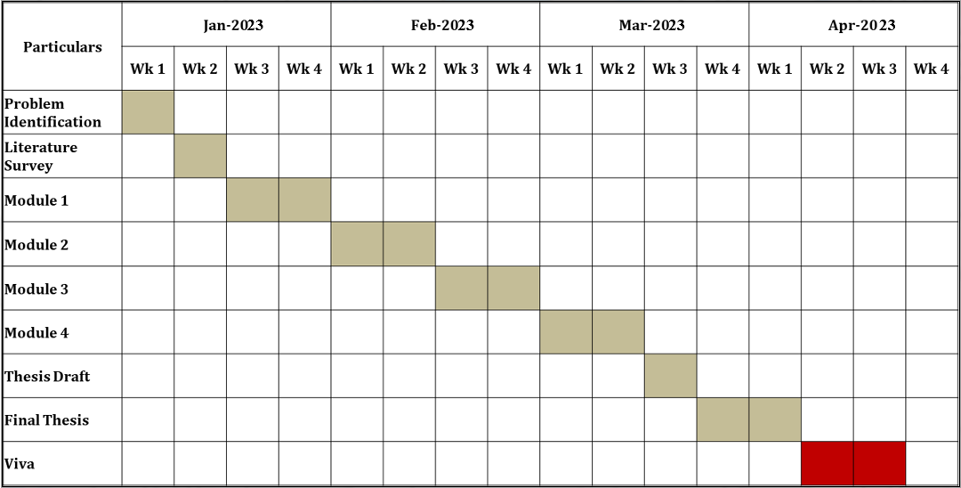
TIMELINE

Slide 16
THANK YOU

